Slide 1
Supplier Ariba Registration and Approval Process

Slide 2
Solution Key Components
1. Supplier Request
2. Supplier Registration
3. Supplier Qualification
4. Preferred Supplier
This is created internally, and a link is sent to suppliers who request to be part of the Palabora Vendor Database.
This entails the Palabora registration and Banking data questionnaires to be completed by Supplier and submitted for approval.
Suppliers can update this information on an ongoing basis.
Process of requesting capacity and industry related experience and qualifying suppliers as a provider of a specific product or service for a specific region.
Process of identifying suppliers for specific commodities and flagging them as Preferred suppliers.

Slide 3
1. Supplier Request

Slide 4
Supplier must provide this information prior receiving a link

Slide 5
Supplier will be sent a link to register on Ariba, see example - Click on “Click here to proceed” - Click on create Account if you already have an Ariba account / Sign up so that you can create an account. - Then complete all the mandatory fields and continue to creating an account.

Slide 6
You can also access the Palabora dashboard from:
www.palabora.co.za
Place your cursor on Suppliers and Tenders → Suppliers → Supplier Login/Register as a New Supplier
Select Supplier Login (meaning you already have an account), then populate your username and password and sign in
Select Register as a New Supplier, so that you can register a SAP business network.
Then you can access the SAP Business Network page, please follow the following steps to see the Palabora questionnaires.

Slide 7
Example1:
Log in using the link or URL
The passwords must be created as follows:
Must be at least 12 characters
Must include at least one number
Case-sensitive
Password can be reset by each user.
Populate your User Name and Password
Retrieve your User Name or Password if forgotten.

Slide 8
The Business Network Dashboard: - Click on the drop-down arrow next to Business Network - Select Ariba Proposals & Questionnaires and the system should take you to the Palabora Dashboard. If not, click on more and select Palabora Copper.

Slide 9
The two registration questionnaires should then appear for you to complete and submit:

Slide 10
2. Supplier Registration

Slide 11
The Banking data questionnaire:
Complete the questionnaire in capital letters, don’t use special characters.
Please use PMC001 as Reference – if you use more than 10 characters, the vendor will not sync to SAP and we will push it back to you
The bank letter must not be older than 3 months
Use the provided sample of the Authorised signatories' letter, and it must be printed on your company letterhead
The ID copy must have a stamp date that is not older than 3 months
After completion, click on “submit entire response” so that it can route to us for approval.

Slide 12
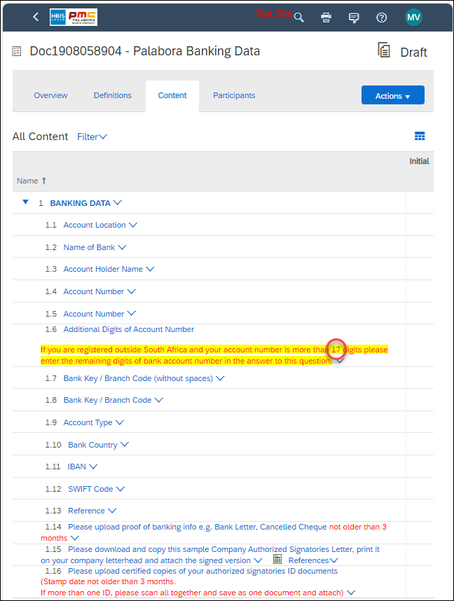
NB: Foreign vendor with account numbers that are longer that 17 digits, please take note of the below note on 1.6:

Slide 13
The Registration questionnaire:
Pay attention to the comments in red as they provide guideline on how to compete the questionnaire.
Complete the questionnaire with capital letters, except the email addresses
Avoid repeating the company name on 1.2 and 1.4
Company registration number is mandatory for SA companies
Select only one region located as per your address/location
Company registration certificate must align with the CIPC
Address populated on the questionnaire must be the same as the address on the registration certificate and CIPC.
Web based emails like Gmails not accepted as our SAP system does not send correspondence to them.
Contact number to be populated in the manner: 0027156586235 (0027 replaces the 0)
Select categories as per your company profile, you must NOT select all commodies
Populate the details of all your active company directors
Select Local Trade On-Site and upload the COIDA certificate if you are rendering your services onsite. Ensure that you populate the correct COIDA certificate number not registration number
BBBEE information to be populated as per your BBBEE certificate
After completion, click on submit entire response so that it can route to us for approval

Slide 14
The Approval Process

Slide 15
After supplier has submitted both the registration and banking data questionnaires, the following approvals will be triggered:
1. Review Registration questionnaire
2. Upload confirmation documents
In
Questionnaires submitted
Internal questionnaire
3rd Approver
4th Approver
5th Approver
6th Approver
7th Approver
8th Approver
1. Confirm banking questionnaire
2. Upload banking confirmation documents
After the 8th approver, Supplier then receives a confirmation that your vendor is registered, but this is not the last step.

Slide 16
3. Supplier Qualification

Slide 17
The supplier qualification in an internal process and requires no action from the supplier.

Slide 18
4. Preferred Supplier

Slide 19
Suppliers will be preferred before they can be synced to SAP to generate a vendor number. This is also an internal process, and the approval process is as follows: Then the vendor is synced to SAP and Vendor number is shared with the supplier along with the terms and conditions. NB: Compliance documents to be updated by supplier on Ariba timeously as they expire. It is the responsibility of the supplier to ensure that their details are always correct and up to date, especially the banking information.
Completion & submission of Supplier Preference questionnaire (By PMC Personnel)
1st Approver
2nd Approver
3rd Approver
4th Approver

